Slide 1

Global Warning(s)

Slide 2
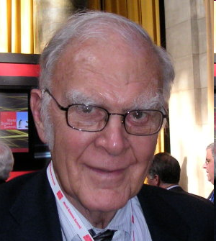
F. Sherwood Roland
Nobel Laureate Chemistry
Ozone Depletion
“What’s the use of having developed a science well enough to make predictions if, in the end, all we’re willing to do is stand around and wait for them to come true?”

Slide 3
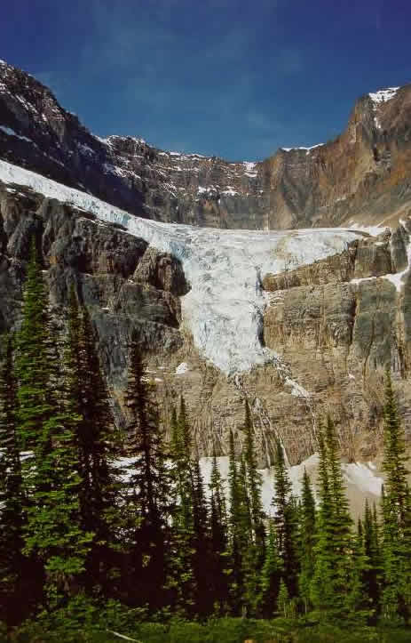


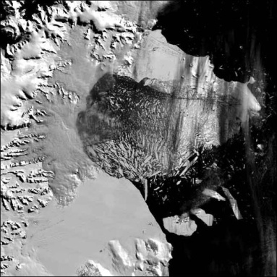
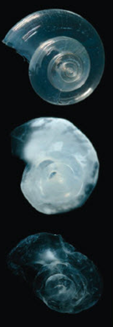

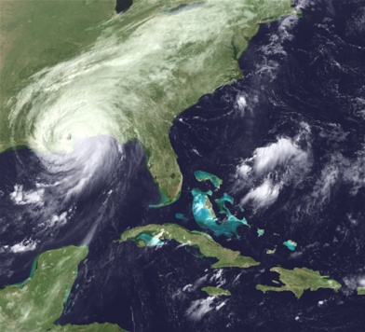
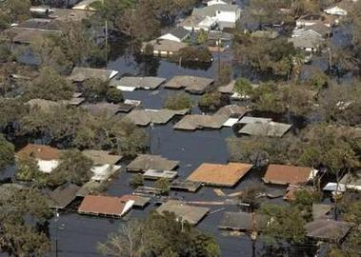
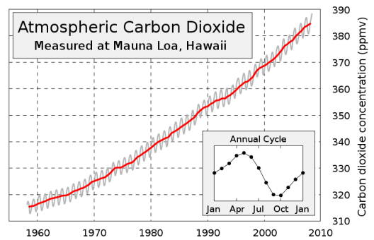
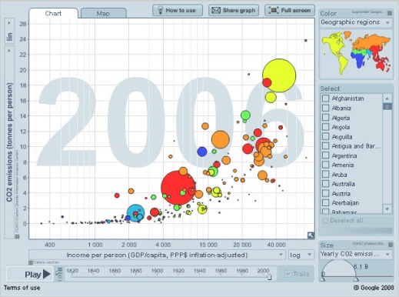


Recognizing the Warning Signs…
Understanding the Data

Slide 4

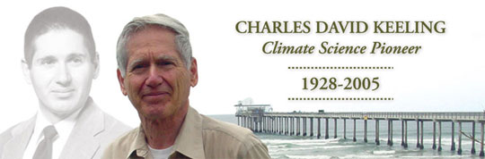
1. What is CO2 telling us?
International Geophysical Year 1957
Scripps Institute of Oceanography
http://rammb.cira.colostate.edu/dev/hillger/IGY.htm

Slide 5
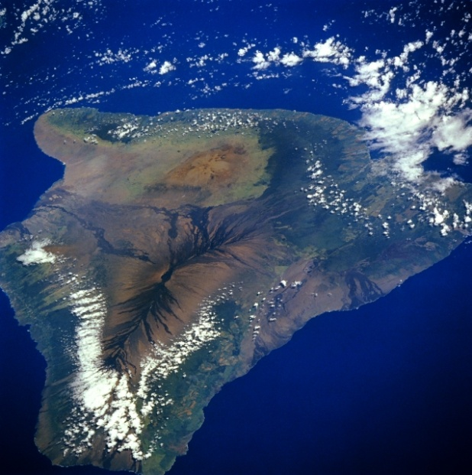
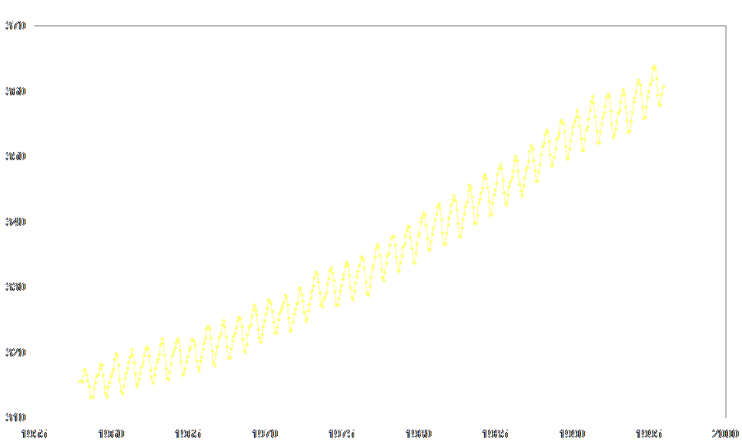
Perhaps one of the most important graphs in history!
C0₂ (ppm)
Date

Slide 6
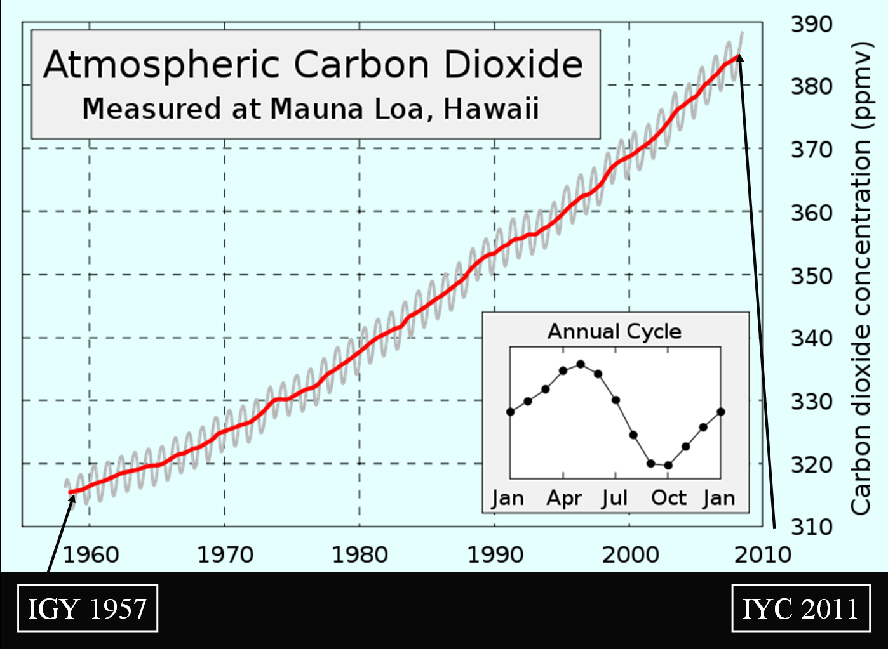
Where are you? Your grandchildren?
IGY 1957
IYC 2011

Slide 7
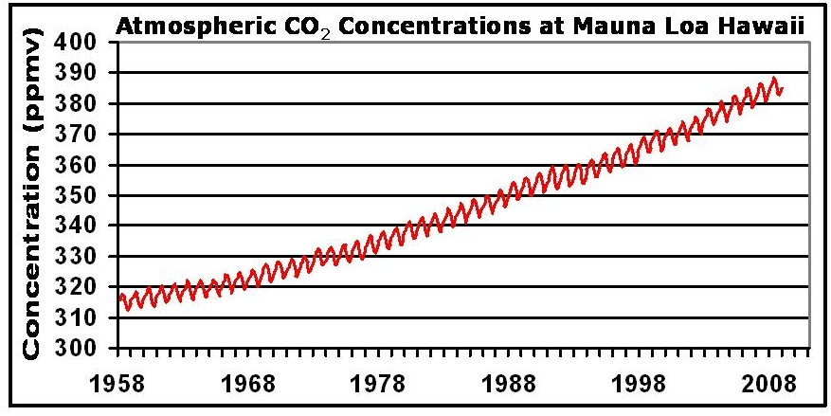
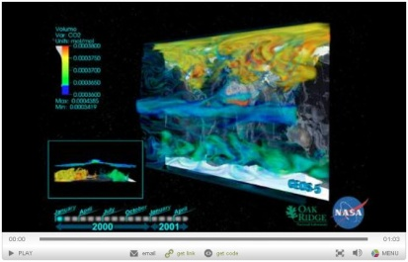
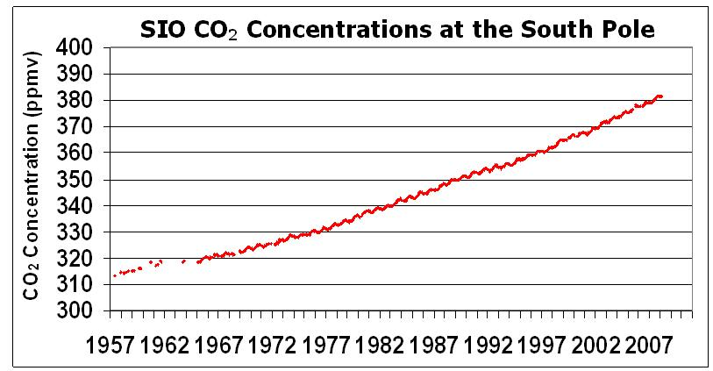

CDIAC, 2010
Go to NASA/Oak Ridge Video
Notes:
7

Slide 8
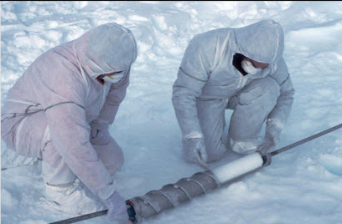
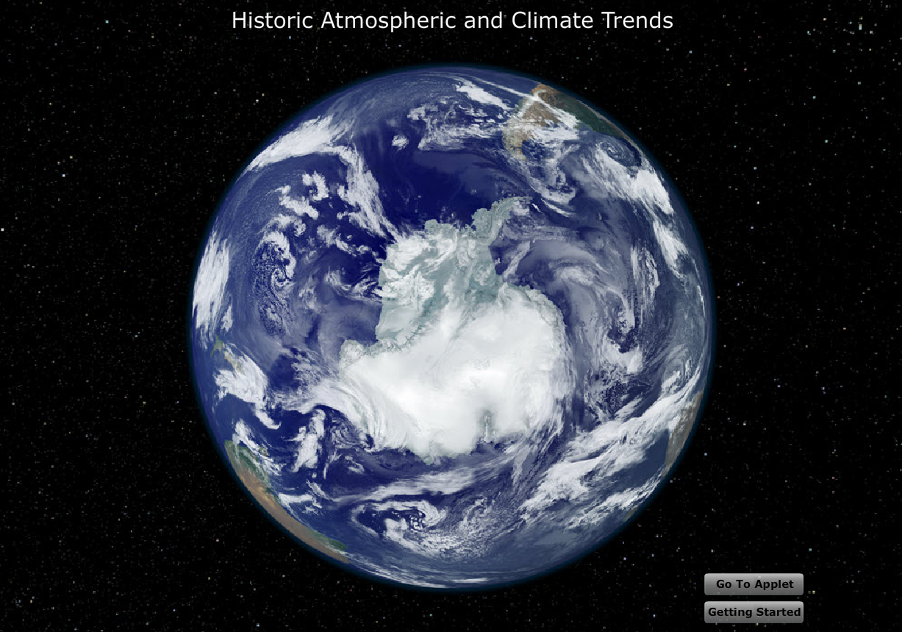
2. Warnings from the Past

Slide 9
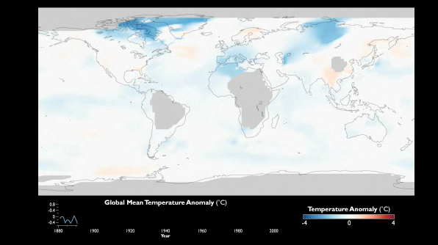
3. What Your Thermometer is Telling You!

Slide 10

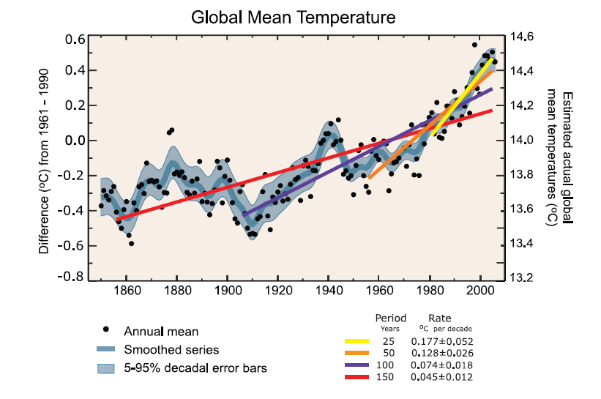
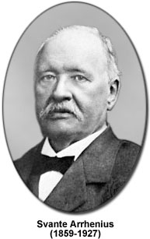



?
IPCC 2007, Climate Change: The Physical Science Basis, Working Group 1, 4th Assessment Report

Slide 11

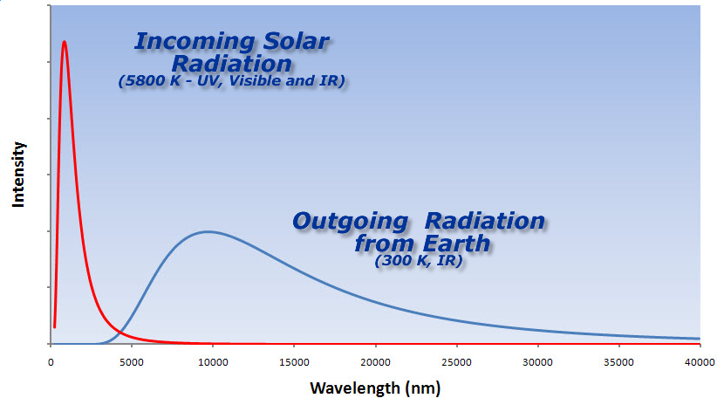
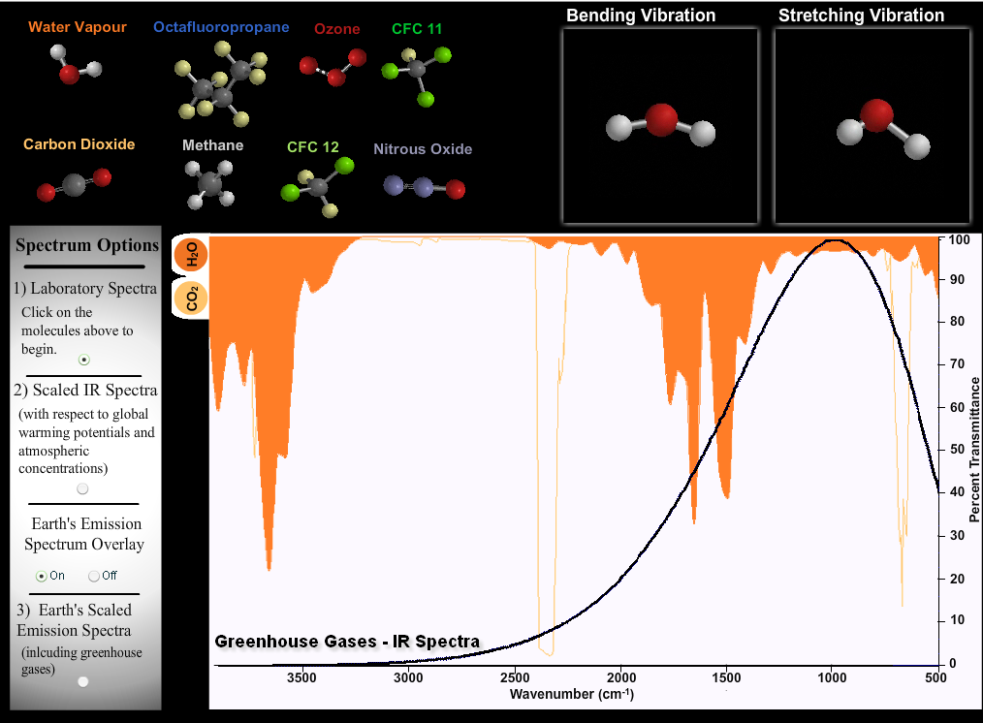
4. Warning – Windows now Closing!

Slide 12
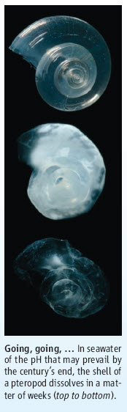
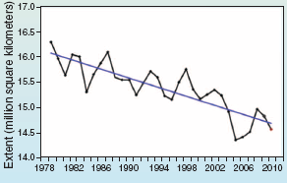
5. Ice-caps and Pteropods – Warnings from Our Fragile Oceans
Hoegh-Guldberg, O., Bruno, J. Science, 328, p 1523, 18 June 2010

Slide 13
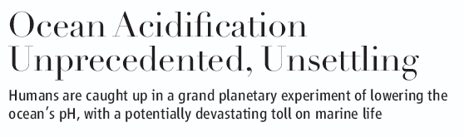

The physics and chemistry of adding an acid to the ocean are so well understood, so inexorable, that there cannot be an iota of doubt—gigatons of acid are lowering the pH of the world ocean, humans are totally responsible, and the more carbon dioxide we emit, the worse it’s going to get.
Ocean pH is lower than it’s been for 20 million years
Models predict drop from a pre-industrial pH of 8.2 to about 7.8 by the end of this century. That would increase the surface ocean’s acidity by about 150% on average.

Slide 14
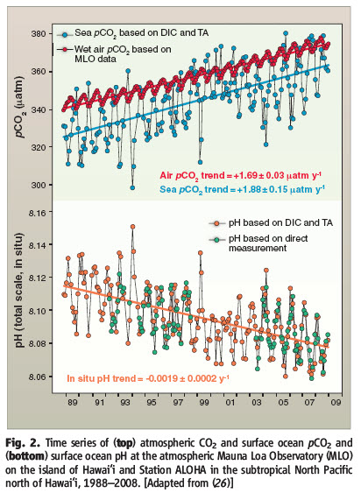
Doney, S. Science, 328 18 June 2010

Slide 15
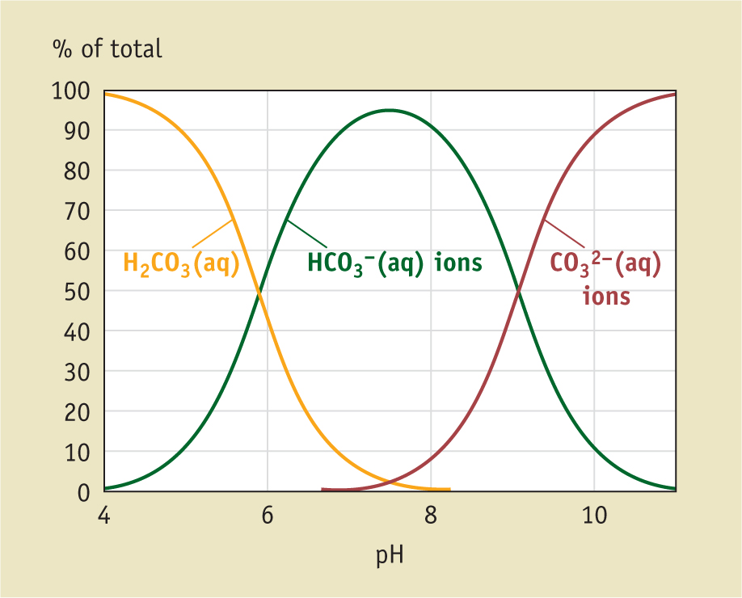
Predicted 2100 pH 7.8
Pre-industrial pH 8.2
Mahaffy, et. al., Chemistry: Human Activity, Chemical Reactivity,
2010, Nelson, p 552

Slide 16
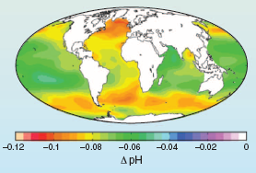
Hoegh-Guldberg, O., Bruno, J. Science, 328, p 1523, 18 June 2010
Sea Surface pH change since Industrial Revolution
Notes:
16
Most of the carbon in seawater is in the form of HCO3-, while the concentrations of CO32- and dissolved CO2 are one and two orders of magnitude lower, respectively. The equilibrium reaction for CO2 chemistry in seawater that most cogently captures its behavior is
CO2 + CO32- + H2O == 2 HCO3-
where I am using double equal signs as double arrows, denoting chemical equilibrium. Since this is a chemical equilibrium, Le Chatlier’s principal states that a perturbation, by say the addition of CO2, will cause the equilibrium to shift in such a way as to minimize the perturbation. In this case, it moves to the right. The concentration of CO2 goes up, while the concentration of CO32- goes down. The concentration of HCO3- goes up a bit, but there is so much HCO3- that the relative change in HCO3- is smaller than the changes are for CO2 and CO32-. It works out in the end that CO2 and CO32- are very nearly inversely related to each other, as if CO2 times CO32- equaled a constant.
Coral reefs are built from limestone by the reaction Ca2+ + CO32- == CaCO3, where Ca is calcium. Acidifying the ocean decreases the concentration of CO32- ions, which by le Chatlier’s principal shifts the equilibrium toward the left, tending to dissolve CaCO3. Note that this is a sort of counter-intuitive result, that adding CO2 should make reefs dissolve rather than pushing carbon into making more reefs. It’s all because of those H+ ions.
http://www.realclimate.org/index.php/archives/2005/07/the-acid-ocean-the-other-problem-with-cosub2sub-emission/

Slide 17
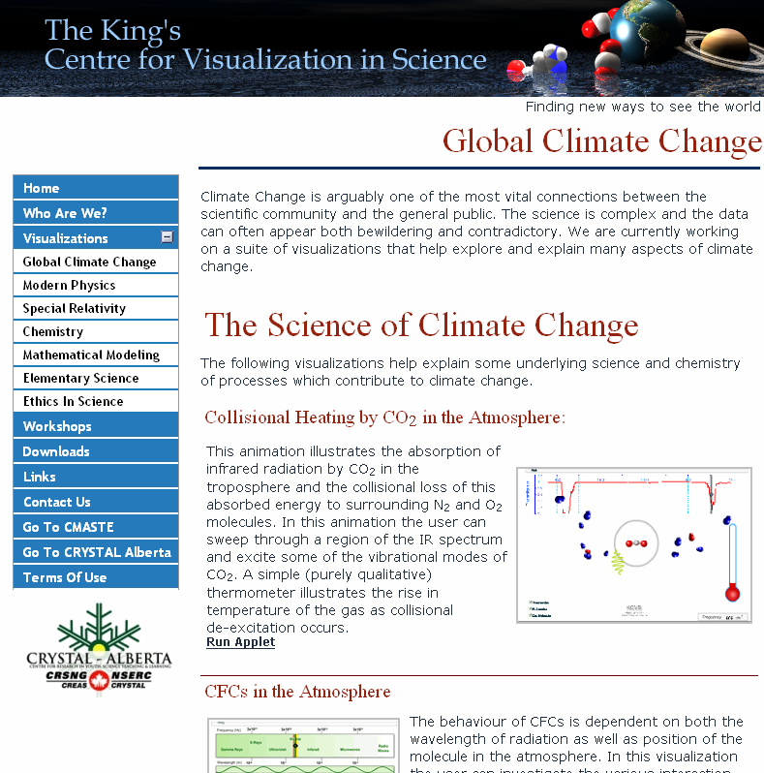
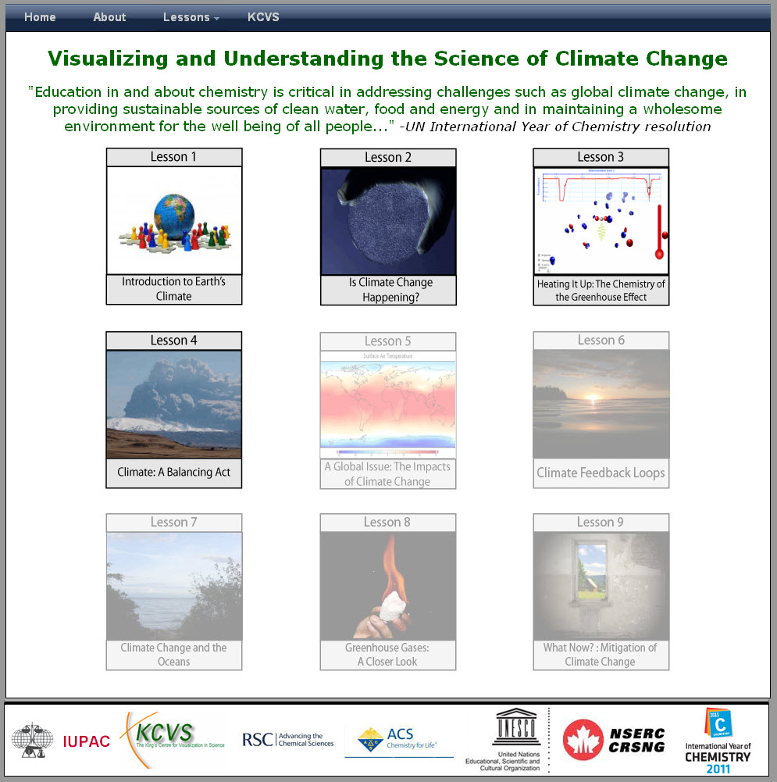
Trying to “turn the ship around”

Slide 18
Thank You!
www.kcvs.ca
www.explainingclimatechange.ca

Slide 19
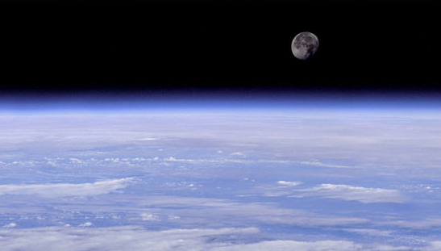
Mass of the Atmosphere
Basic Facts:
Atmospheric pressure 100 kPa
1 Pa = 1N/m²
Radius of Earth 6.38 X 10⁶m
What mass of a column of air 1m² at the base will exert a force of 100 kN ?
Every square m of the Earth’s surface supports 10⁴ kg of air
Ans: mg = 100 000 N
m = 10⁴ kg

Slide 20
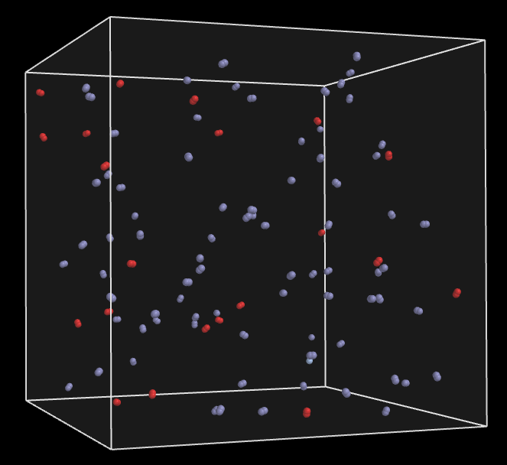
How many molecules are there in the atmosphere?
Basic Facts:
Atmospheric is mostly N₂ and O₂
“molar mass” approximately 30 g/mol
Mass of atmosphere 5 X 10¹⁸ kg

Slide 21
How Much CO₂ in ppm Does a Barrel of Oil Produce?
Basic Facts:
Carbon-based fuel releases 3.15 times its mass in CO₂
Mass of a barrel of oil is about 135 kg or
1 barrel releases 425 kg CO₂
CO₂ has a molar mass of 44g/mol
1 barrel releases 425 kg of CO_{2;} in moles this is
Since the atmosphere contains 1.7 X 10²⁰ mol one barrel will release
This is the fraction of CO₂ relative to the entire atmosphere – multiply by 1 million to get the parts-per-million or ppm. So, 1 barrel releases an additional

Slide 22
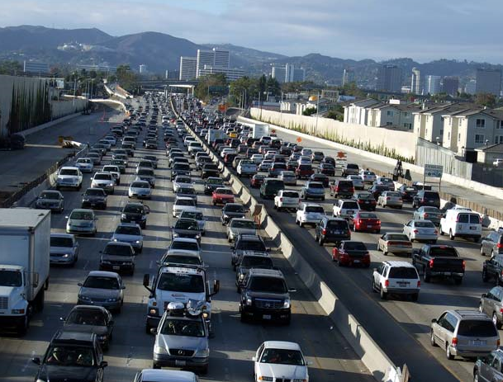
Is the observed increase in CO₂ “natural” or …
Basic Facts:
1 barrel of oil releases 6 X 10⁻¹¹ ppm of new CO₂ into the atmosphere
30 billion barrels of oil are consumed annually
Slope = 1.8 ppm/a
46 ppm
25 a

Slide 23
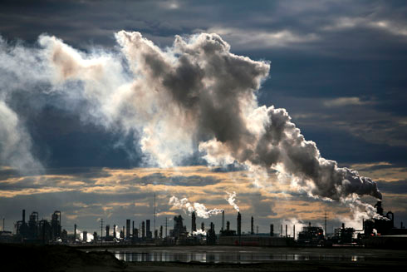
A Bit Closer to home… what is the annual Carbon footprint of the Alberta Oil Sands in ppm?
Basic Facts:
Fort Mac produces 1.5 million barrels of oil per day
Annual Carbon footprint is 40 million tonnes of carbon dioxide
1 barrel of oil releases 6 X 10⁻¹¹ ppm of new CO₂ into the atmosphere
…but – that’s not the end of the story!

Slide 24
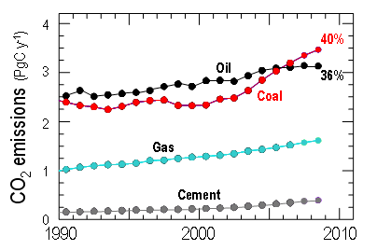
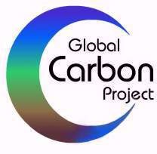
Components of Fossil Fuel Emissions
Le Quéré et al. 2009, Nature Geoscience

Slide 25
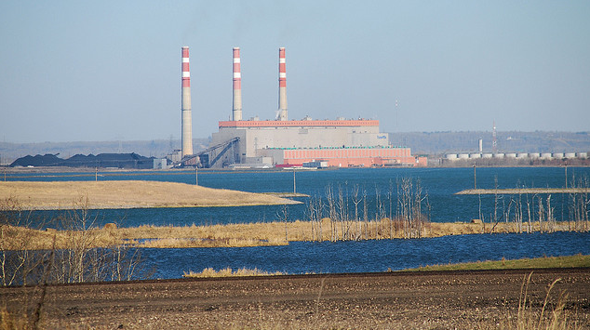
How about Coal-Generated Power?
Basic Facts:
The Sundance Coal-fired Power Generation Plant on Lake Wabamum produces 2126 MWH
Annual Carbon footprint is 17.5 million tonnes of carbon dioxide
The Sundance plant produces roughly 7.5/40 times as much CO₂ as The Alberta Oil Sands
In other words – Sundance adds
(or about “half-a-Fort Mac”)

Slide 26
Let’s Re-run the Numbers…
Basic Facts:
CO₂ sources by percent:
  Coal 40%
  Oil 36%
  Natural Gas 20%
  Other 4%
If the burning of oil accounts for only 36% of the total CO₂ loading then the total (anthropogenic) loading is …
So – where is the rest going?

Slide 27



How much energy do we receive from the Sun?
Basic Facts:
Average Solar Constant is 1.366 kW/m²
Solar constant is “spread” over the top of atmosphere of the Earth so each square metre receives

Slide 28
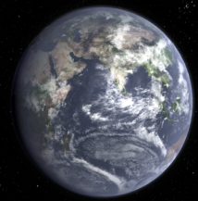
Thank Goodness for Greenhouse Gases!
Basic Facts:
Earth’s albedo is about 0.35
Solar constant So is about 1366 W/m2
σ = 5.67 X 10⁻⁸ Wm⁻²K⁻⁴
Energy Absorbed from Sun
Energy emitted by Earth
Earth’s effective surface temperature
should be – 15 C!

